Slide 1


Slide 2



CREATING TABLE
IN JDBC

Slide 3

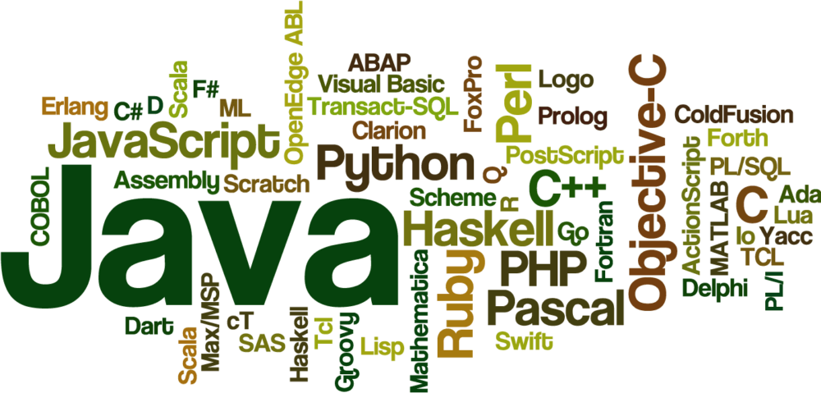


Slide 4
JDBCUtil.java(Connector program)
import java.sql.Connection; import java.sql.DriverManager; public class JDBCUtil { //JDBC and database properties. private static final String DB_DRIVER = "oracle.jdbc.driver.OracleDriver"; private static final String DB_URL = "jdbc:oracle:thin:@localhost:1521:XE"; private static final String DB_USERNAME = "system"; private static final String DB_PASSWORD = "oracle"; public static Connection getConnection(){ Connection conn = null;

Slide 5
CONTINUED..
try{ //Register the JDBC driver Class.forName(DB_DRIVER); //Open the connection conn = DriverManager. getConnection(DB_URL, DB_USERNAME, DB_PASSWORD); if(conn != null){ System.out.println("Successfully connected."); }else{ System.out.println("Failed to connect."); } } catch(Exception e){ e.printStackTrace(); } return conn; } }
Notes:
Successfully connected.
Table created successfully

Slide 6
CREATING A TABLE USING PREPARED STATEMENTS:
import java.sql.Connection; import java.sql.PreparedStatement; import com.codesjava.util.JDBCUtil; public class JDBCTest { public static void main(String args[]){ Connection conn = null; PreparedStatement preparedStatement = null; String query = "create table EMPLOYEE(" + "EMPLOYEE_ID NUMBER(5) NOT NULL, " + "NAME VARCHAR(20) NOT NULL, " + "SALARY NUMBER(10) NOT NULL, " + "PRIMARY KEY (EMPLOYEE_ID) )";

Slide 7
CONTINUED..
try{ //get connection conn = JDBCUtil.getConnection(); //create preparedStatement preparedStatement = conn.prepareStatement(query); //execute query preparedStatement.execute(); //close connection preparedStatement.close(); conn.close(); System.out.println("Table created successfully."); }catch(Exception e){ e.printStackTrace(); } } }

Slide 8
INSERT RECORDS USING PREPARED STATEMENTS
import java.sql.Connection; import java.sql.PreparedStatement; import com.codesjava.util.JDBCUtil; public class JDBCTest { public static void main(String args[]){ Connection conn = null; PreparedStatement preparedStatement = null; String query = "insert into EMPLOYEE " + "(EMPLOYEE_ID, NAME, SALARY) " + "values (?,?,?)"; try{ //get connection conn = JDBCUtil.getConnection(); //create preparedStatement preparedStatement = conn.prepareStatement(query);

Slide 9
CONTINUED..
//set values preparedStatement.setInt(1, 1); preparedStatement.setString(2, "Bharat"); preparedStatement.setInt(3, 62000); //execute query preparedStatement.executeUpdate(); //close connection preparedStatement.close(); conn.close(); System.out.println("Record inserted successfully."); }catch(Exception e){ e.printStackTrace(); } } }
Notes:
Successfully connected.
Record inserted successfully.

Slide 10
UPDATES RECORDS USING PREPARED STATEMENTS:
import java.sql.Connection; import java.sql.PreparedStatement; import com.codesjava.util.JDBCUtil; public class JDBCTest { public static void main(String args[]){ Connection conn = null; PreparedStatement preparedStatement = null; String query = "update EMPLOYEE set " + "SALARY = ? " + "where EMPLOYEE_ID = ? "; try{ //get connection conn = JDBCUtil.getConnection(); //create preparedStatement preparedStatement = conn.prepareStatement(query);

Slide 11
CONTINUED..
//set values preparedStatement.setInt(2, 1); preparedStatement.setInt(1, 65000); //execute query preparedStatement.executeUpdate(); //close connection preparedStatement.close(); conn.close(); System.out.println("Record updated successfully."); }catch(Exception e){ e.printStackTrace(); } } }

Slide 12
SELECTING THE DATA FROM DATABASE
import java.sql.Connection; import java.sql.PreparedStatement; import java.sql.ResultSet; import com.codesjava.util.JDBCUtil; public class JDBCTest { public static void main(String args[]){ Connection conn = null; PreparedStatement preparedStatement = null; String query = "select EMPLOYEE_ID, NAME from EMPLOYEE"; try{ //get connection conn = JDBCUtil.getConnection(); //create preparedStatement preparedStatement = conn.prepareStatement(query);

Slide 13
CONTNUED..
//execute query ResultSet rs = preparedStatement.executeQuery(query); while (rs.next()) { String empId = rs.getString("EMPLOYEE_ID"); String empName = rs.getString("NAME"); System.out.println("EmpId : " + empId); System.out.println("EmpName : " + empName); } //close connection preparedStatement.close(); conn.close(); }catch(Exception e){ e.printStackTrace(); } } }

Slide 14
DELETING THE DATA FROM DATABASE
import java.sql.Connection; import java.sql.PreparedStatement; import com.codesjava.util.JDBCUtil; public class JDBCTest { public static void main(String args[]){ Connection conn = null; PreparedStatement preparedStatement = null; String query = "delete EMPLOYEE " + "where EMPLOYEE_ID = 1 "; try{ //get connection conn = JDBCUtil.getConnection(); //create preparedStatement preparedStatement = conn.prepareStatement(query); //execute query preparedStatement.executeUpdate();

Slide 15
CONTINUED..
//close connection preparedStatement.close(); conn.close(); System.out.println("Record deleted successfully."); }catch(Exception e){ e.printStackTrace(); } } }

Slide 16

THANK YOU

